Slide 1
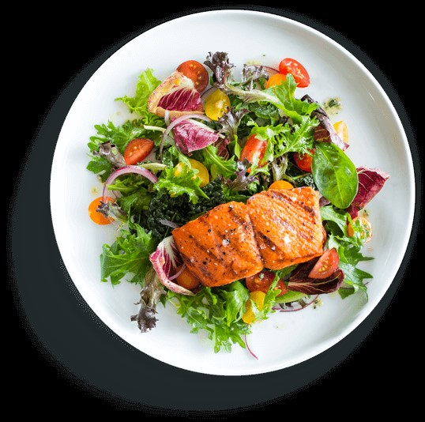
A NOVEL TIME-AWARE FOOD RECOMMENDER-SYSTEM BASED ON DEEP LEARNING AND GRAPH CLUTERING
SAI KRISHNA 20J41A05C2
VISHNU SAI 20J41A05G5
M.SRINIDHI 20J41A05F9
MD.asif 20J41A05F7
VENKAT SAI 20J41A05D8

Slide 2
CONTENTS
ABSTRACT
INTRODUCTION
EXISTING SYSTEM AND PROPOSED SYSTEM
ALGORITHMS
SYSTEM ARCHITECTURE
MODULES
RESULT
PROJECT REQUIREMENTS
CONCLUSION
FUTURE SCOPE

Slide 3
ABSTRACT
This project aims in helping users adjust their eating habits and achieve a healthier diet using food recommendation system.
This project aims to develop a new hybrid food recommender-system to overcome the shortcomings of previous systems, such as ignoring food ingredients, time factor, cold start users, cold start food items and community aspects.
The proposed method involves two phases: food content-based recommendation and user-based recommendation. Graph clustering is used in the first phase, and a deep-learning based approach is used in the second phase to cluster both users and food items.
Besides a holistic-like approach is employed to account for time and user-community related issues in a way that improves the quality of the recommendation provided to the user. We compared our model with a set of state-of-the-art recommender-systems using five distinct performance metrics: Precision, Recall, F1, AUC and NDCG. Experiments using dataset extracted from “Allrecipes.com” demonstrated that the developed food recommender-system performed best.

Slide 4
INTRODUCTION
In recent years, researchers have become more interested in recommender-systems as one of the most successful personalization tools on the web . It can be used to help the user identify the right service, reduce the information overload, guide the user towards some personalized behavior, and find user's favorite items within a large amount of information, among others.
In a typical recommender-system, users' interests are discovered and items and services are recommended accordingly. In a variety of lifestyle applications and services, food recommendation plays an important role as a tool assisting users to change behavior and adopt healthy lifestyle .
Typically, food recommendation attempt to provide the user with a personalized food recommendation in terms of recipes, scale of change and time required to achieve specific objectives that might be associated with diet requirement or any lifestyle demand .
Traditionally, research in food recommendation has seen little attention when compared to recommendation in other leisure and entertainment fields (e.g., music, book, shopping recommendation systems), possibly due to cultural barriers and difficulty to predict what people might like to eat.

Slide 5
EXISTING SYSTEM
Ingredients of foods: Most previous food recommender-systems rely primarily on historical ratings of users to draw upon food recommendations through a collaborative filtering approach that ignores food ingredients. This is due to the observation that a given food is usually preferred by an individual because it contains ingredients, he/she may like to eat. This may overlook some important aspects in the recommendation. For example, foods containing chicken wings may be a person's favorite food, while he/she may be allergic to some types of spices that can be used during the food preparation. Therefore, collaborative filtering recommender-systems may not be enough to account for such user's preferences and constraints.
Time factor: Traditional recommender-systems are based on the premise that users with similar preferences in the past will have similar tastes in the future. Accordingly, these recommender-systems use static data and ignore potential changes in user's food preferences, diet or life style that can occur over time in realistic scenarios.

Slide 6
Cold start users and cold start foods: Due to the fact that users often rate just a few foods, traditional collaborative filtering-based food recommender systems have difficulty recognizing active user neighbors or similar foods. Accordingly, collaborative Filtering-based food recommendation are only able to suggest foods to users who have rated enough foods. Cold start users, who have rated only few food items, are thereby ignored. Similarly, new food items (food cold start) that have not attracted yet enough ratings from users are ignored as well by such a collaborative filtering-based approach.
Users' community: Another issue, which is again ignored in existing recommender-systems, is the user's neighborhood or community aspect. Intuitively, community aspect can be utilized to predict the rating of unseen food item and the success likelihood of a given diet, extrapolating from active users' activities in the neighborhood. Typically, community aspect can be handled using clustering-based models. Nevertheless, it has been shown that such an approach also suffers from several other difficulties as well, which are somehow inherent to clustering techniques employed (e.g., optimal number of clusters, efficiency of similarity measures employed).

Slide 7
PROPOSED SYSTEM
Ingredients-aware food recommender-system: Unlike traditional collaborative-based food recommender systems, our model integrates both collaborative filtering-based model (user-based phase) and content-based model (food-based phase). As a result, a set of foods that both suit the user's preferences and utilize his/her previous ratings are recommended.
Time-aware food recommender-system: A novel time-aware similarity measure that takes into account changes in food preferences or diet over time is developed in this paper. This makes the proposal suitable to handle cases where users change his/her rating / preferences over time.
Trust-aware food recommender-system: A trust-aware food recommender-system is developed to overcome the cold start user and cold start foods problems of the traditional collaborative filtering-based food recommender-systems. Our proposed model builds a trust network of users based on trust (follower following) statements to predict user ratings efficiently.

Slide 8
The trust network generation plays an important role in addressing the neighbor selection problem. Trust statements can be used to predict the rating of unseen items in food recommender-systems since there is a high correlation between users' trust and user ratings-based similarity measure. The user's trust network and the user ratings-based similarity are integrated in this study to address the data sparsity problem utilizing knowledge that is stored outside of the user's local neighborhood of similarity.
Community-aware food recommender-system: Contrary to previous works where users' communities are not considered in the food recommendation process, our model explicitly accounts for such aspects where the optimal number of users' clusters is determined automatically. Moreover, using a graphical like representation
where edge weights are calculated according to user ratings-based similarity and trust network, the
proposed method accommodates sparse datasets.

Slide 9
Existing system and proposed system
DISADVANTAGES OF EXISTING SYSTEM:
ADVANTAGES OF PROPOSED SYSTEM:
Time factor in user rating is ignored.
Analysis of user-user interaction is rather light.
Trust relationships among users are neglected.
Only few works attempted to integrate user ratings and food content.
Healthy Recommendation
Ingredients-Aware
Time-Aware
Food Similarity-Based Recommendation

Slide 10
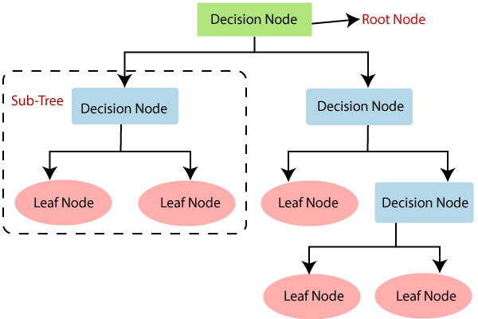
ALGORITHMS
Decision Tree Classifiers
Decision tree classifiers capture decision-making knowledge from data. They partition data based on outcomes of a test. If all data belongs to one class, a leaf with that class label is created. Otherwise, the process recurs for subsets, forming a tree.

Slide 11
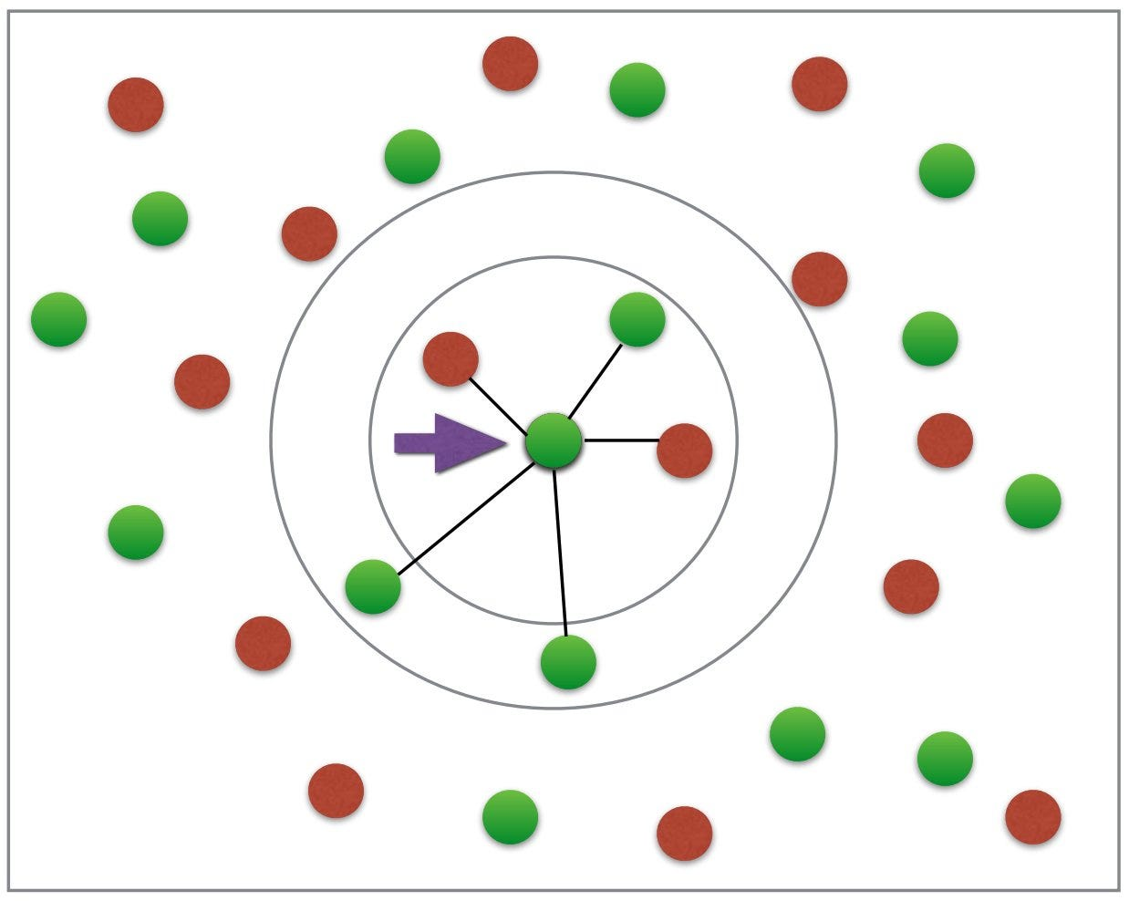
K-Nearest Neighbors (KNN)
KNN is a simple yet potent classification algorithm. It assigns labels based on similarity measures to neighbors in the training data. Non-parametric and lazy, it doesn't "learn" until given a test example.

Slide 12
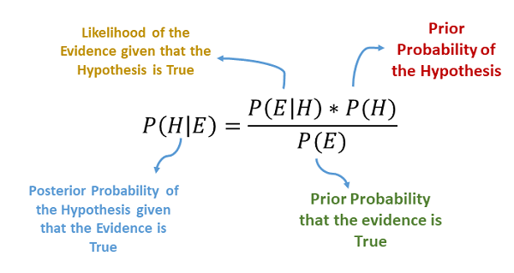
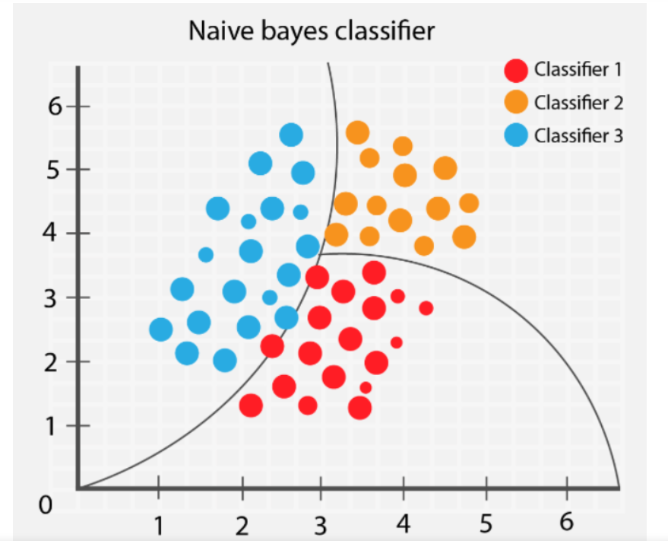
Naïve Bayes:
Naïve Bayes is a supervised learning method assuming independence between features. Though easy to implement and fast, users may find it challenging to interpret. A new presentation of results aims to simplify understanding and deployment. The classifier, a linear model, has performance comparable to other methods.

Slide 13
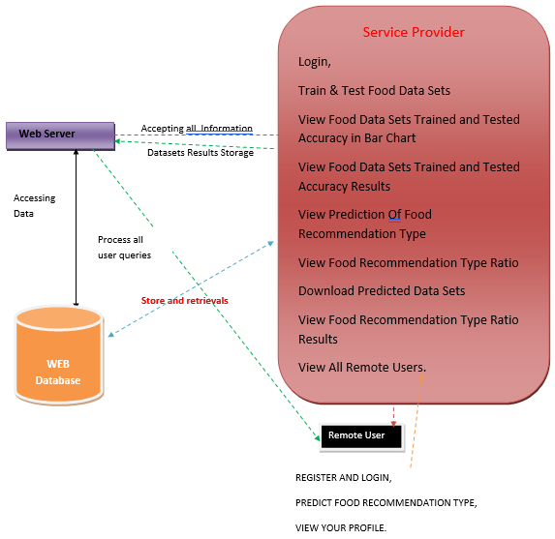
SYSTEM ARCHITECTURE
Fig : System Architecture

Slide 14
MODULES
Service Provider Module:
Train & Test Food Data Sets: Perform data training and testing operations.
View Food Data Sets Trained and Tested Accuracy (Bar Chart): Visualize accuracy results in a bar chart.
View Food Data Login: Authenticate using valid credentials (username and password).
Trained and Tested Accuracy Results: Review detailed accuracy results.
View Food Recommendation Type Ratio Results: Examine results of recommendation type ratios.
View All Remote Users: Access a list of all remote users.

Slide 15
View and Authorize Users Module:
Admin Privilege: Admin can view the registered user list.
User Details: View user information, including username, email, and address.
Authorize Users: Admin can grant authorization to users.
Remote User Module:
User Registration: Users must register before performing any actions.
Registration Data Storage: User details are stored in the database.
Operations:
After successful login, users can:
Register and Login: Perform registration and login actions.
Predict Food Recommendation Type: Utilize food recommendation predictions.
View Your Profile: Access and view their user profile.

Slide 16
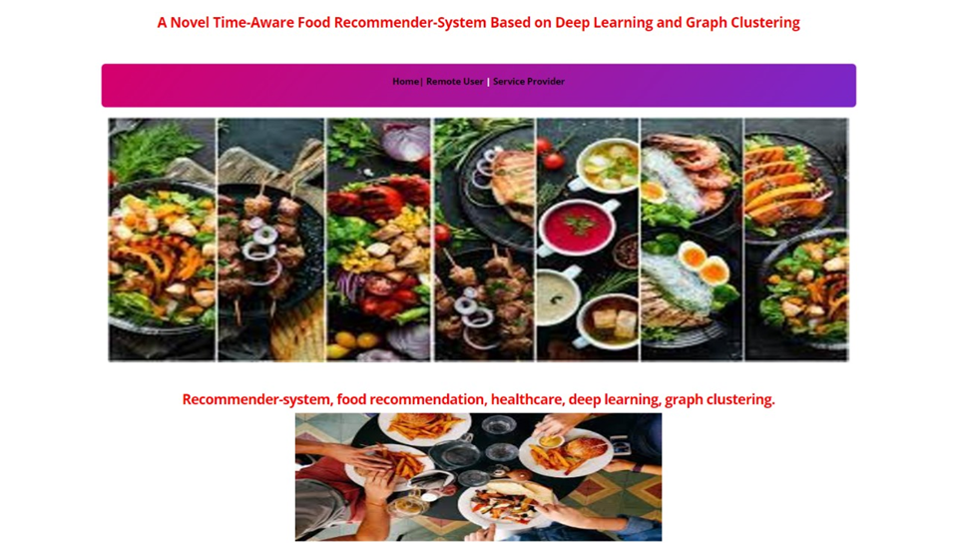

RESULT SCREENS

Slide 17
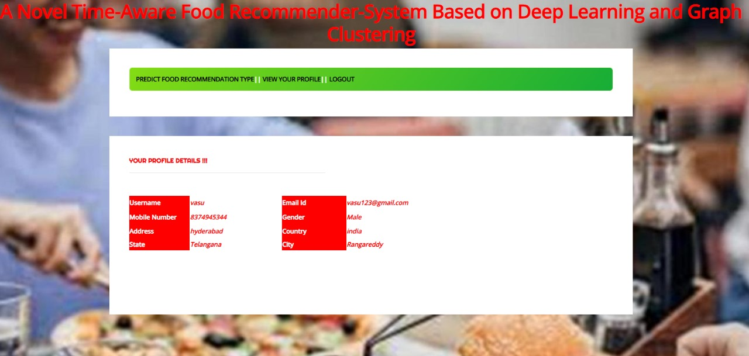
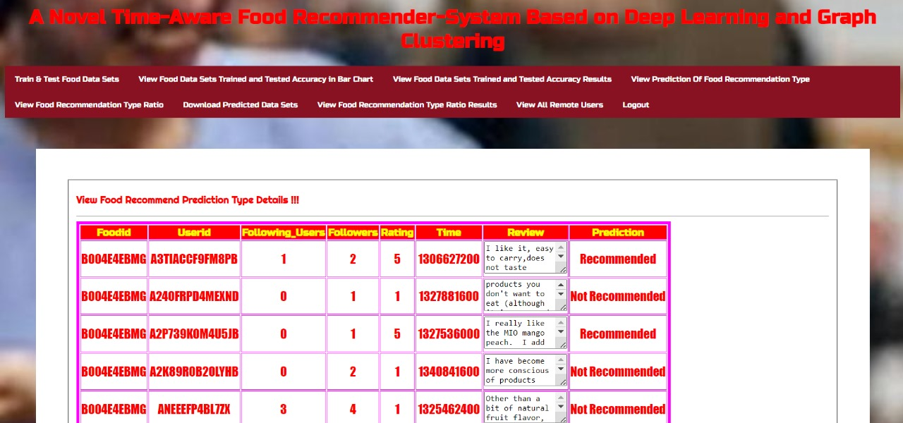

Slide 18
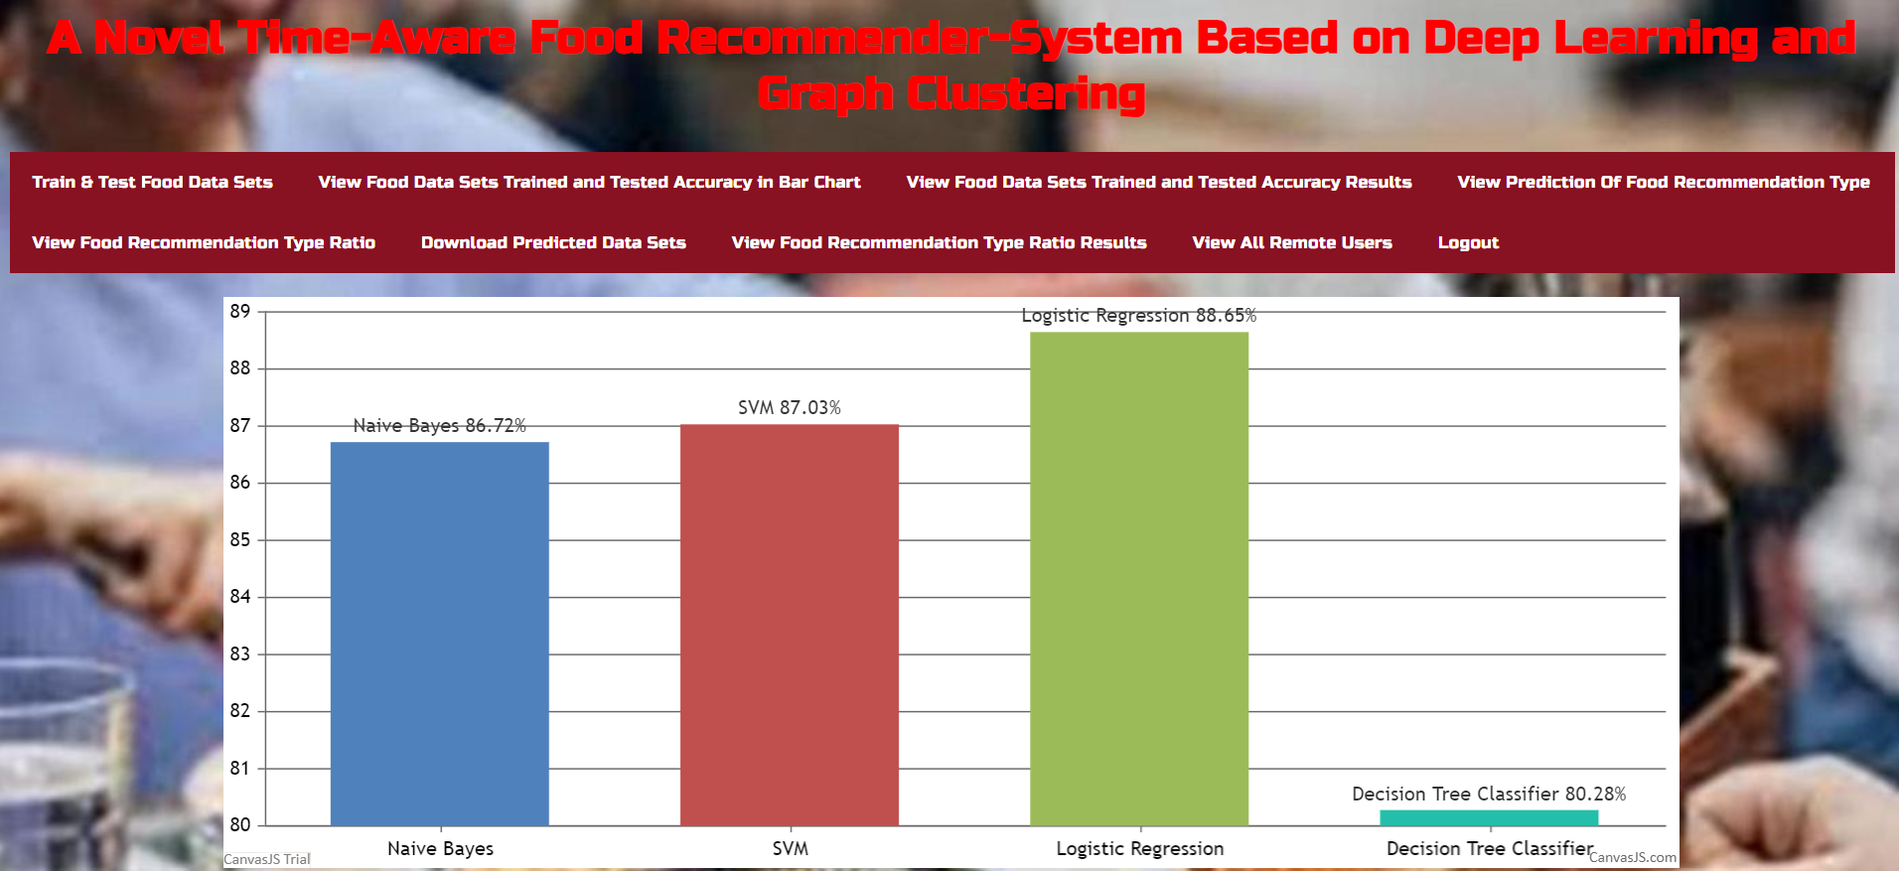
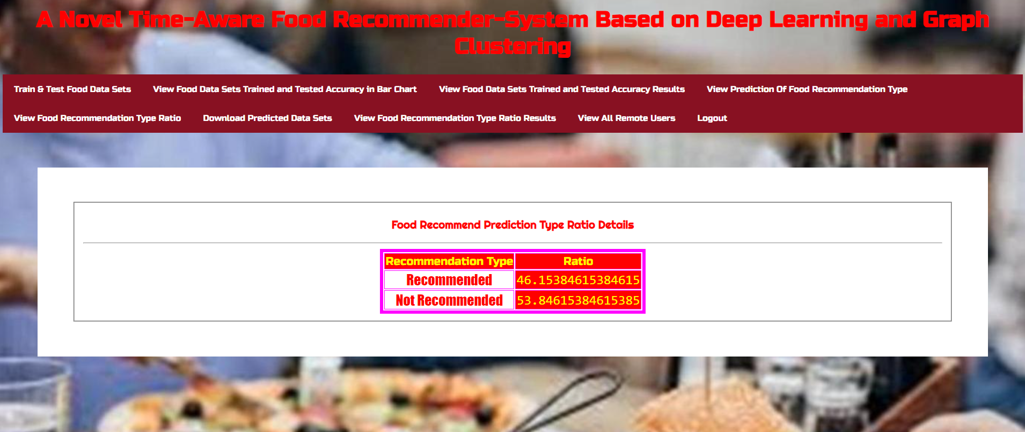

Slide 19
PROJECT REQUIREMENTS
HARDWARE REQUIREMENTS
PROCESSOR: Pentium-IV
RAM: 4GB (min)
HARD DISK: 20GB
KEYBOARD: Standard Windows
MOUSE: Two or Three button mouse
MONITOR: SVGA
SOFTWARE REQUIREMENTS
OS: Windows 7 Ultimate
CODING LANGUAGE: Python
BACKEND: Python
DESIGNING: Html, CSS, Javascript
DATABASE: MySQL(WAMP Server)

Slide 20
CONCLUSION
The Internet's growth and user base expansion have led to the widespread use of recommender systems. Food recommender systems, integral to lifestyle applications, are evolving to address previous limitations.
This project introduces a novel hybrid food recommender system, resolving issues like ingredient, time stamp, cold start users, cold start foods, and user community neglect. The approach combines food content-based and user-based recommendations, leveraging graph clustering and deep learning.
Evaluation against state-of-the-art methods across multiple metrics demonstrates its superior performance. Using user-based and content-based models as well as using time information, trust network, and user communities, the proposed method addresses all four issues simultaneously and aims to improve the final accuracy of the recommender-system.

Slide 21
FUTURE SCOPE
Future work will integrate user side information for enhanced recommendations and consider nutritional aspects to promote healthier eating habits, potentially mitigating non-infectious disease symptoms.
We aim to incorporate the side information of users (e.g., gender, age, weight, height, location, and culture) into the food recommendation framework in the future works to further improve the final performance of the food recommendation.
In addition, a proper eating habit can lessen the severity of symptoms associated with non-infectious diseases. In future works, we aim to use nutritional characteristics of each food as additional information and recommend foods according to each person's health status and diseases.

Slide 22
THANK YOU!

